Slide 1
Natural Language Programming with Python
Fall 2021

Slide 2
Topic | Notebook | Exercise book | Solution
Kick-off
NLP Intro
Pre-process data | Pre processing (latuda) | Exercise – Vaccine tweets | Solution 1
EDA | EDA with text (clothing reviews) | Build on Vaccine Tweet – do EDA | Solution 2
Text Classification - Sentiment Analysis | Sentiment Analysis Example Sentiment Analysis Google – SA -DL Sentiment Analysis - DL | Build on Vaccine Tweet – do polarity 20 Build on Vaccine Tweet – do logistic regression 20
Text Classification - Topic Classification (label) | Text Classification
Text Summarization
Text Generation
Sentiment Analysis
Topic Modeling
Notes:
https://colab.research.google.com/github/tensorflow/docs/blob/master/site/en/tutorials/keras/text_classification.ipynb#scrollTo=hKY4XMc9o8iB

Slide 3
 | Topic | Notebook | Exercise book | Solution
 | Kick-off
 | NLP Intro
DONE | Working in CoLab | 0 – Working in Google CoLab | create folders, upload data |  | Put outbreaks2 into CHAT Exercise 15 min
DONE | Pre-process data | 1 - Pre processing (latuda) | Basic terms | nltk, textblob nltk downloads | Exercise – Vaccine Tweets (30 min)
 | EDA | 2 - EDA with text (latuda) | run a pre-built model, use a lexicon, count vector, n-grams | textblob | Exercise – Vaccine Tweets EDA (30
 |  | 3 – Sent. Analysis Example | lexicon vs. training, labels | textblob
 |  | 4 – Sentiment Analysis (3 versions) | simple. logistic regression, deep learning | scikit-learn, tensorflow, keras
 |  | 5 – Build a corpus | corpus
 |  | 6 – Text Summary | use a corpus
 |  | 7 – Text Classification | google version, model export
 |  | 8 – Text Generation
 |  | 9 – Topic Modeling
Notes:
https://colab.research.google.com/github/tensorflow/docs/blob/master/site/en/tutorials/keras/text_classification.ipynb#scrollTo=hKY4XMc9o8iB

Slide 4
Housekeeping
In case of technical problems:
Something wrong on my end (e.g. power outage), I will send you an email.
Something wrong on your end, please send me a text message. 508-769-6446
jcodygroup@gmail.com
We have 4 hours for each session
I will try to give you an opportunity to stand and stretch every hour.
We will take at least one 15-minute break near the halfway point.

Slide 5
About me
Experience:
25+ years consulting and training experience
Extensive work with “big data” and analytics
15 years working with various data visualization tools
Education
Ed. M., Technology, Innovation & Education, Harvard University
PhD Candidate, Education Policy, University of Massachusetts, Amherst

Slide 6
NLP

Slide 7
What is Natural Language Processing (NLP)?
NLP is a broad field, encompassing a variety of tasks, including:
Part-of-speech tagging: identify if each word is a noun, verb, adjective, etc.)
Named entity recognition (NER): identify person names, organizations, locations, medical codes, etc
Question answering
Speech recognition
Text-to-speech and Speech-to-text
Topic modeling
Sentiment classification
Text Classification
Text Generation
Language modeling
Translation

Slide 8
I like to organize it this way…
What group does this text belong to?
What is in this text?
What can I say about this text?
Text classification
spam/not spam
finance/health/IT/etc.
semantic analysis
Named Entity Recognition
Topic Modeling
Text Summarization
Text Generation
Q & A
I have not included translation, speech-to-text, etc.

Slide 9
Our focus
NLP is a broad field, encompassing a variety of tasks, including:
Part-of-speech tagging: identify if each word is a noun, verb, adjective, etc.)
Named entity recognition (NER): identify person names, organizations, locations, medical codes, etc
Question answering
Speech recognition
Text-to-speech and Speech-to-text
Topic modeling
Sentiment classification
Text Classification
Text Generation
Language modeling
Translation

Slide 10
General Process Flow
Tokenization
Remove Contractions
Stop word removal
Spell Checking
Feature Engineering/ Dimensionality Reduction
Analysis/ Modeling
Stemming
Noise Removal
Documents of interest
Lemmatization
Specialized Cleaning
Sentiment Analysis
Text Summarization
Text Classification
Text Generation
Topic Modeling
Normalization
Cleaning
Pre-processing

Slide 11
Is NLP part of Machine Learning?
Yes.

Slide 12
Terminology
Task
Algorithm
Model

Slide 13
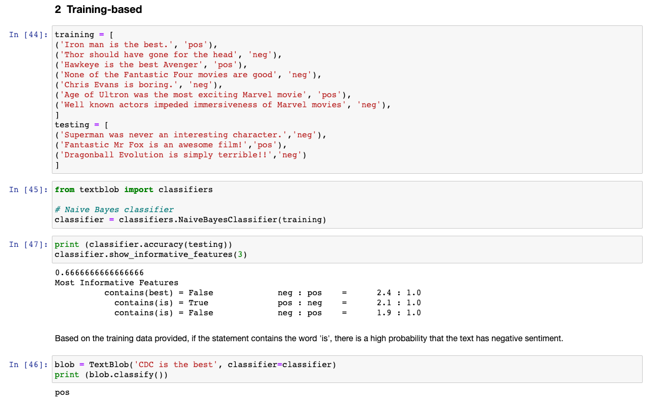
Machine Learning algorithms
Supervised
regression
Unsupervised
clustering

Slide 14
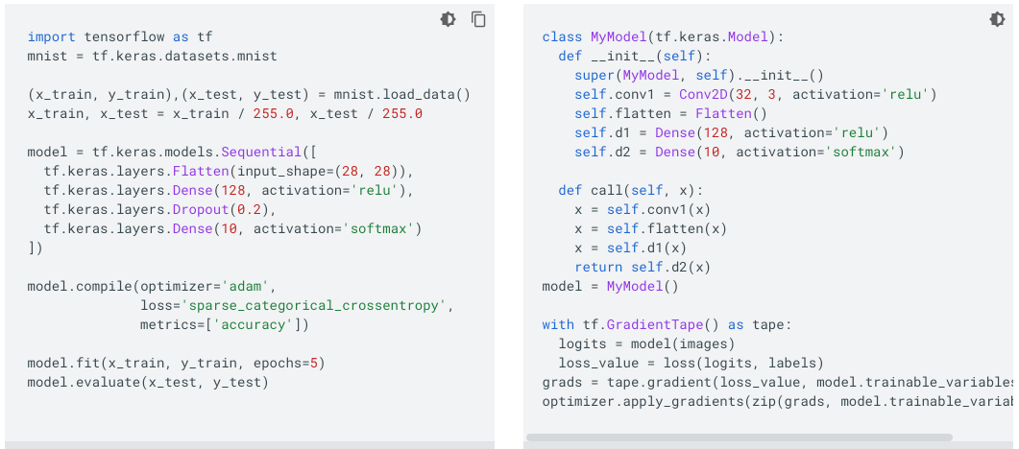
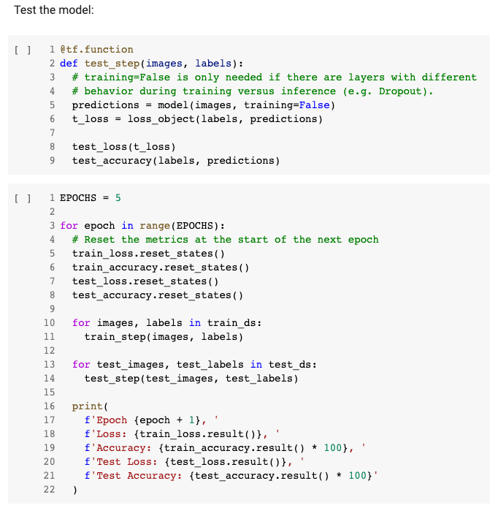
What do we mean by ‘it’s an API’?

Slide 15
Our Question
Our data set contains comments from patients about medications they have been taking.
Our question is, can we classify the comments?
Can we determine the sentiment (pos, neg, neutral) of the comment?
If we were to receive a new comment, can we accurately place it into a predefined category based on the content?

Slide 16
Collect & Pre-process data
Our data set contains comments from patients about medications they have been taking.
Our question is, can we classify the comments?
Can we put each comment into a pre-defined groups?
Can we determine the sentiment (pos, neg, neutral) of the comment?

Slide 17
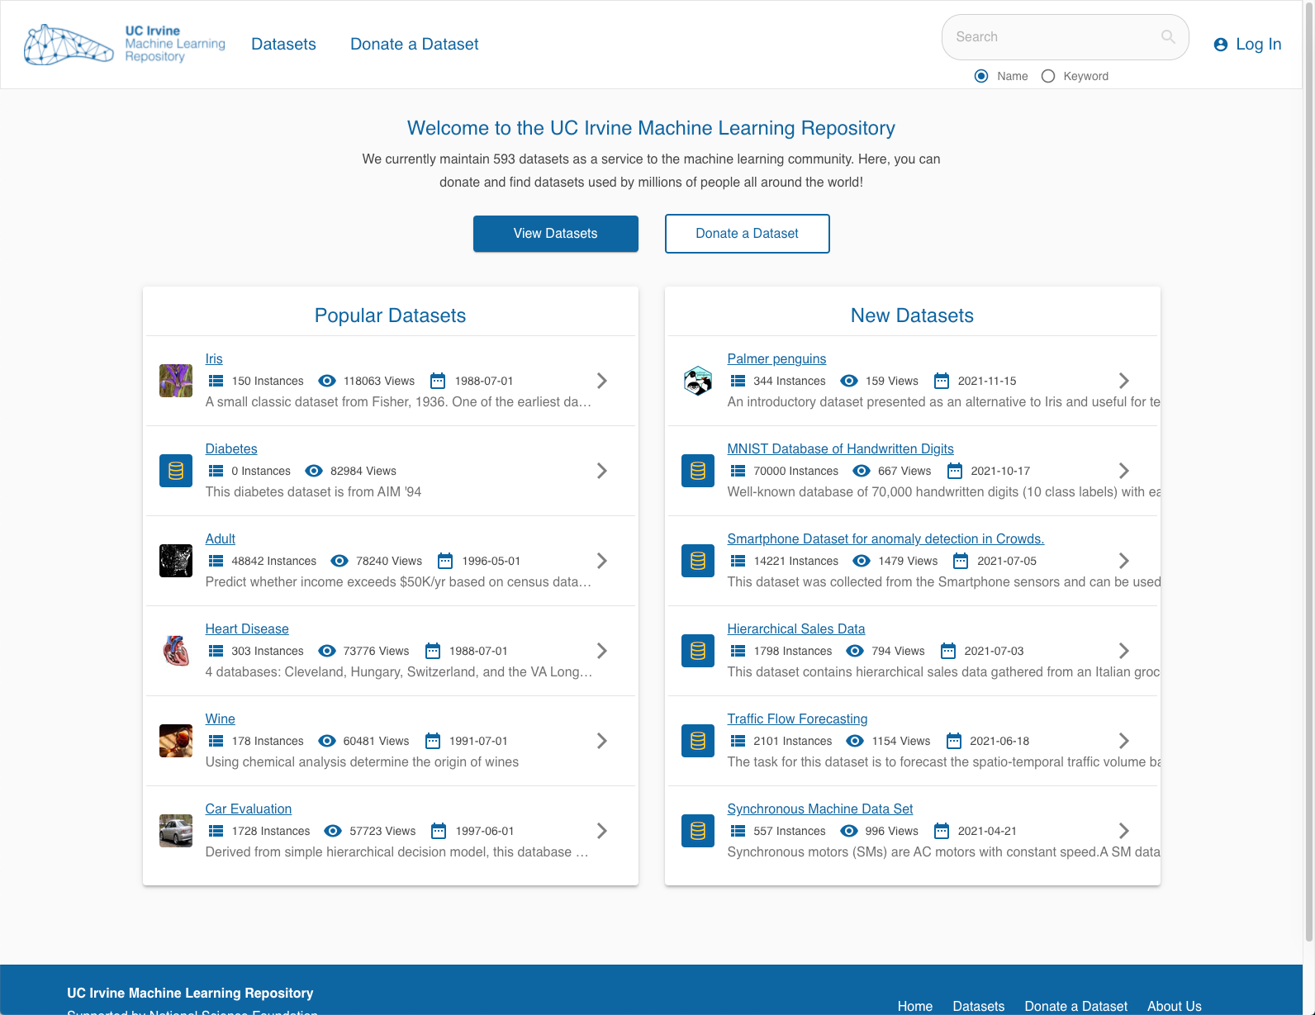
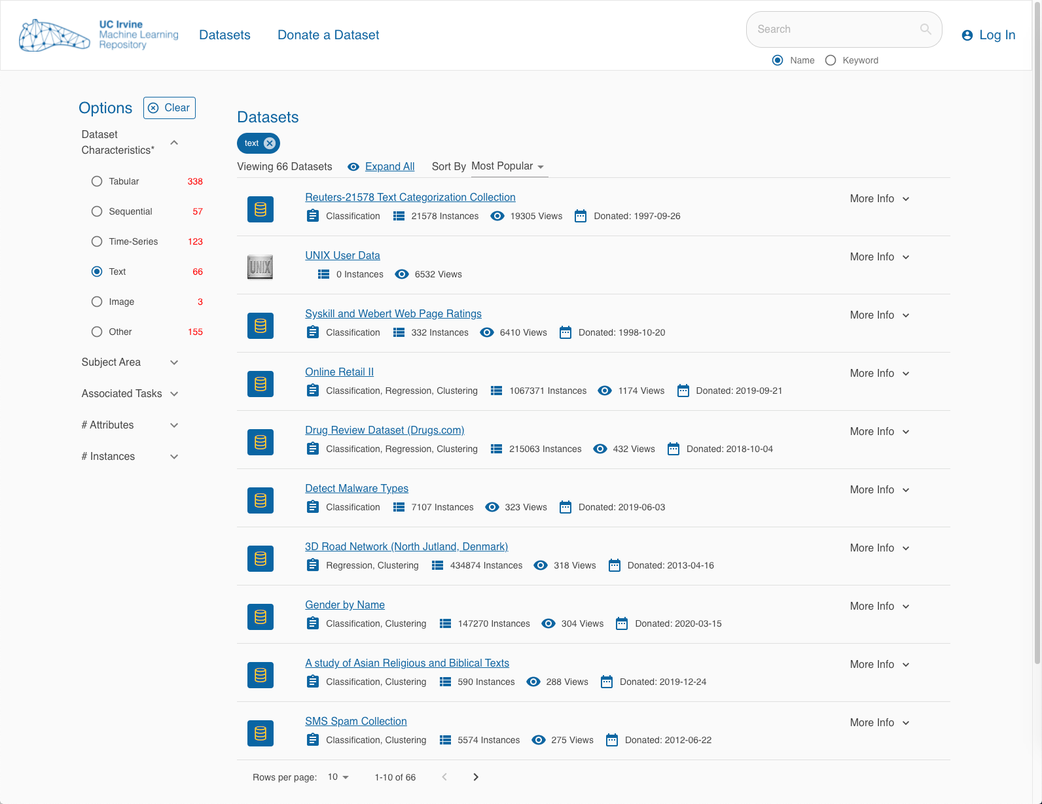
UCI data

Slide 18
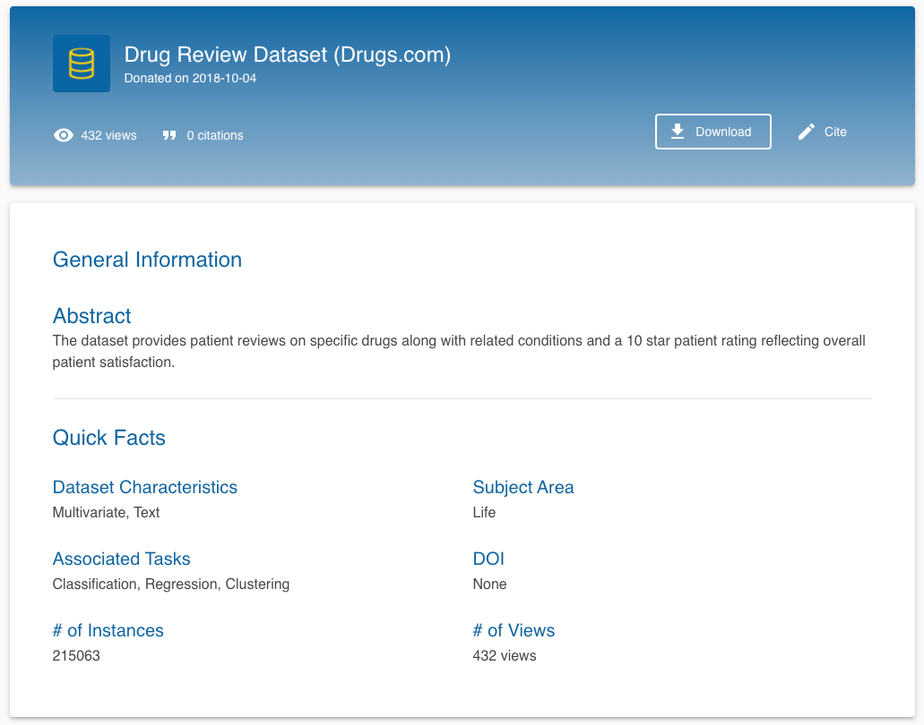
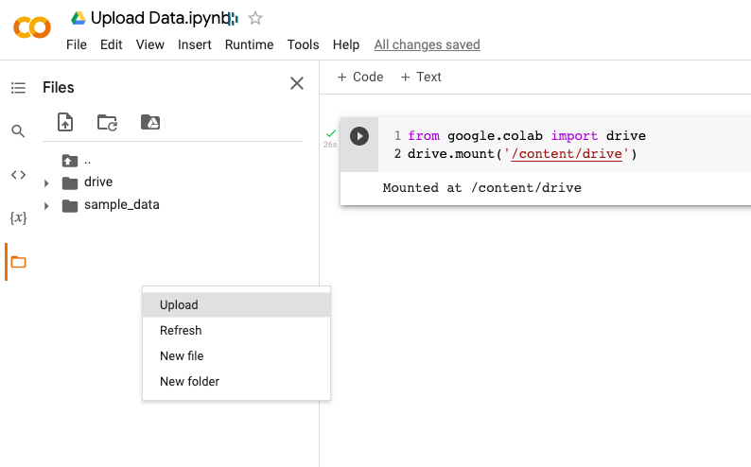
UCI data

Slide 19
DR1 – Pre-processing of text data
Topics
Contractions
Tokenization
Noise cleaning
spaces
lowercase
special characters
Stop words
Stemming
Lemmanization
imports
os
pandas
nltk
regex
contractions
pyspellchecker
string

Slide 20
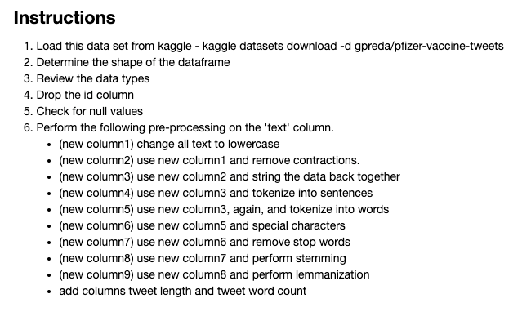
Exercise - Preprocessing
Use the Exercise – Preprocessing notebook as a starter

Slide 21
EDA with Text

Slide 22
Types of text classifiers

Slide 23
DR2 – EDA with text
Topics
Parts of Speech (POS)
Shallow parsing
Named Entity Recognition (SpaCy)
N-grams (nltk, sklearn)
imports
pandas
matplotlib
seaborn
nltk
contractions
regex
collections
yellowbrick
SpaCy
textacy
sklearn

Slide 24
Exercise – EDA with text
Use your Exercise – Preprocessing notebook
Add columns for polarity and subjectivity.
Create charts to show distributions of :
polarity
retweets
user followers
user friends
favorites
review length
word count
polarity by location
retweets by location
After stop words have been removed, what are the top 10:
unigrams
bigrams
Add two other charts or tables you think might be interesting to see.

Slide 25
Topic Modelling tutorial
https://www.kaggle.com/arthurtok/spooky-nlp-and-topic-modelling-tutorial

Slide 26
Start Text Classification

Slide 27
Feature Engineering
raw text data will be transformed into feature vectors and new features will be created using the existing dataset. We will implement the following different ideas in order to obtain relevant features from our dataset.
Count vectors - Count Vector is a matrix notation of the dataset in which every row represents a document from the corpus, every column represents a term from the corpus, and every cell represents the frequency count of a particular term in a particular document.
TF-IDF vectors - TF-IDF score represents the relative importance of a term in the document and the entire corpus. TF-IDF score is composed by two terms: the first computes the normalized Term Frequency (TF), the second term is the Inverse Document Frequency (IDF), computed as the logarithm of the number of the documents in the corpus divided by the number of documents where the specific term appears.
word level - Matrix representing tf-idf scores of every term in different documents
n-gram level - N-grams are the combination of N terms together. This Matrix representing tf-idf scores of N-grams
character level - Matrix representing tf-idf scores of character level n-grams in the corpus
Word embedding - A word embedding is a form of representing words and documents using a dense vector representation. The position of a word within the vector space is learned from text and is based on the words that surround the word when it is used. Word embeddings can be trained using the input corpus itself or can be generated using pre-trained word embeddings such as Glove, FastText, and Word2Vec. Any one of them can be downloaded and used as transfer learning.
Text/NLP features – counts of nouns, verbs, words, characters

Slide 28
Word Embedding
Following snnipet shows how to use pre-trained word embeddings in the model. There are four essential steps:
Loading the pretrained word embeddings
Creating a tokenizer object
Transforming text documents to sequence of tokens and pad them
Create a mapping of token and their respective embeddings

Slide 29
Model Building - Classifiers
Naive Bayes Classifier
Linear Classifier
Support Vector Machine
Bagging Models
Boosting Models
Shallow Neural Networks
Deep Neural Networks
Convolutional Neural Network (CNN)
Long Short Term Modelr (LSTM)
Gated Recurrent Unit (GRU)
Bidirectional RNN
Recurrent Convolutional Neural Network (RCNN)
Other Variants of Deep Neural Networks

Slide 30
Naive Bayes Classifier - Naive Bayes is a classification technique based on Bayes’ Theorem with an assumption of independence among predictors. A Naive Bayes classifier assumes that the presence of a particular feature in a class is unrelated to the presence of any other feature
Linear Classifier - Logistic regression measures the relationship between the categorical dependent variable and one or more independent variables by estimating probabilities using a logistic/sigmoid function.
Support Vector Machine - Support Vector Machine (SVM) is a supervised machine learning algorithm which can be used for both classification or regression challenges. The model extracts a best possible hyper-plane / line that segregates the two classes.
Bagging Models - Random Forest models are a type of ensemble models, particularly bagging models. They are part of the tree based model family.
Boosting Models - Boosting models are another type of ensemble models part of tree based models. Boosting is a machine learning ensemble meta-algorithm for primarily reducing bias, and also variance in supervised learning, and a family of machine learning algorithms that convert weak learners to strong ones. A weak learner is defined to be a classifier that is only slightly correlated with the true classification (it can label examples better than random guessing).

Slide 31
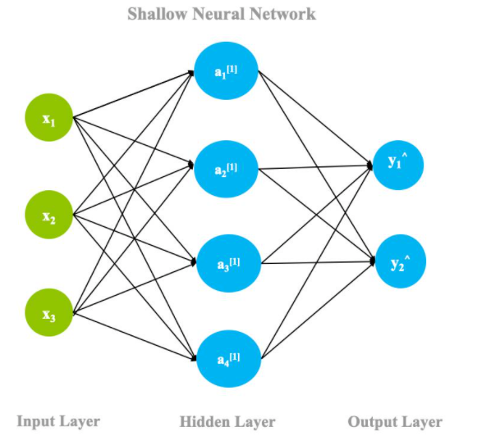
Shallow Neural Networks - A neural network is a mathematical model that is designed to behave similar to biological neurons and nervous system. These models are used to recognize complex patterns and relationships that exists within a labelled data. A shallow neural network contains mainly three types of layers – input layer, hidden layer, and output layer.
https://developer.ibm.com/articles/an-introduction-to-deep-learning/

Slide 32
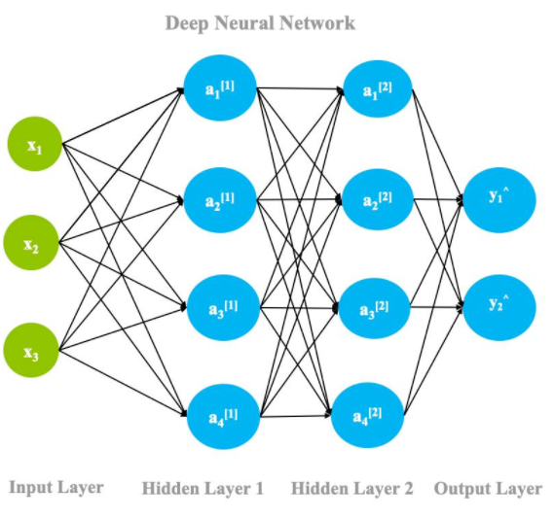
Deep Neural Networks
Convolutional Neural Network (CNN)
Long Short Term Modelr (LSTM)
Gated Recurrent Unit (GRU)
Bidirectional RNN
Recurrent Convolutional Neural Network (RCNN)
Other Variants of Deep Neural Networks
https://developer.ibm.com/articles/an-introduction-to-deep-learning/

Slide 35
End Text Classification

Slide 36
Processing natural language text and extract useful information from the given word, a sentence using machine learning and deep learning techniques requires the string/text needs to be converted into a set of real numbers (a vector) — Word Embeddings.
Word Embeddings or Word vectorization is a methodology in NLP to map words or phrases from vocabulary to a corresponding vector of real numbers which used to find word predictions, word similarities/semantics.
The process of converting words into numbers are called Vectorization.
Word embeddings help in the following use cases.
Compute similar words
Text classifications
Document clustering/grouping
Feature extraction for text classifications
Natural language processing.

Slide 37
Vectorization
converting input data from its raw format (i.e. text ) into vectors of real numbers which is the format that ML models support
vectorization is a step in feature extraction. The idea is to get some distinct features out of the text for the model to train on, by converting text to numerical vectors.
Bag of Words: Tokenization > Vocabulary Creation > Vector Creation
Notes:
https://neptune.ai/blog/vectorization-techniques-in-nlp-guide

Slide 38
The raw news titles were transformed into a cleaned format containing only the essential information (last column of the above picture). The next step is to further transform the cleaned text into a form that the machine learning model can understand. This process is known as Vectorizing. In our context, each news title is converted to a numerical vector representative of that particular title. There are many vectorization techniques, but in this article, we will focus on the three widely used vectorization techniques- Count vectorization, N-Grams, TF-IDF, and their implementation in Python.
In the count vectorization technique, a document term matrix is generated where each cell is the count corresponding to the news title indicating the number of times a word appears in a document, also known as the term frequency. The document term matrix is a set of dummy variables that indicates if a particular word appears in the document. A column is dedicated to each word in the corpus. The count is directly proportionate to the correlation of the category of the news title. This means, if a particular word appears many times in fake news titles or real news titles, then the particular word has a high predictive power of determining if the news title is fake or real.
N-Grams
Similar to the count vectorization technique, in the N-Gram method, a document term matrix is generated and each cell represents the count. The difference in the N-grams method is that the count represents the combination of adjacent words of length n in the title. Count vectorization is N-Gram where n=1. For example, “I love this article” has four words and n=4.
if n=2, i.e bigram, then the columns would be — [“I love”, “love this”, ‘this article”]
if n=3, i.e trigram, then the columns would be — [“I love this”, ”love this article”]
if n=4,i.e four-gram, then the column would be -[‘“I love this article”]
The n value is chosen based on performance.
Term Frequency-Inverse Document Frequency (TF-IDF)
Similar to the count vectorization method, in the TF-IDF method, a document term matrix is generated and each column represents a single unique word. The difference in the TF-IDF method is that each cell doesn’t indicate the term frequency, but the cell value represents a weighting that highlights the importance of that particular word to the document.
The second term of the equation helps in pulling out the rare words. What does that mean? If a word appeared multiple times across many documents, then the denominator df will increase, reducing the value of the second term. Term frequency or tf is the percentage of the number of times a word (x) occurs in the document (y) divided by the total number of words in y.
Notes:
https://towardsdatascience.com/nlp-in-python-vectorizing-a2b4fc1a339e

Slide 39
A typical workflow
Define the question
Collect
Prepare
Perform EDA
Feature Engineering
Apply Techniques
Deploy/
Share Insights

Slide 40
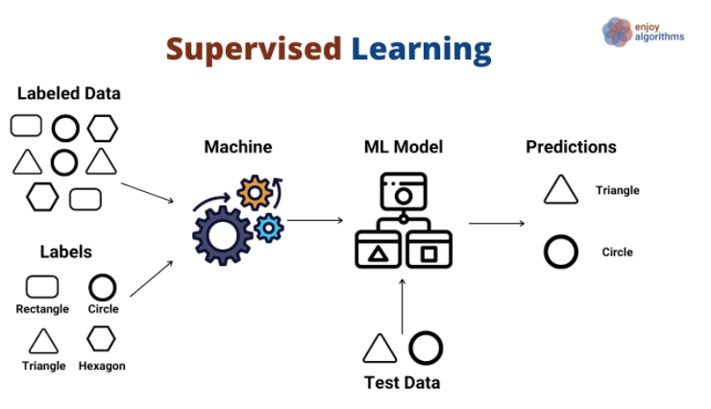
https://medium.datadriveninvestor.com/supervised-vs-unsupervised-machine-learning-732d49413986

Slide 41
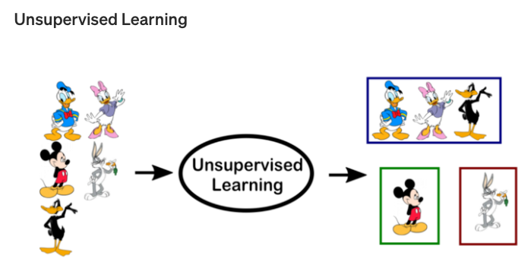
https://towardsdatascience.com/supervised-vs-unsupervised-learning-14f68e32ea8d

